Slide 1

MANAGEMENT OF NATURAL RESOURCES
Coal And Petroleum

Slide 2
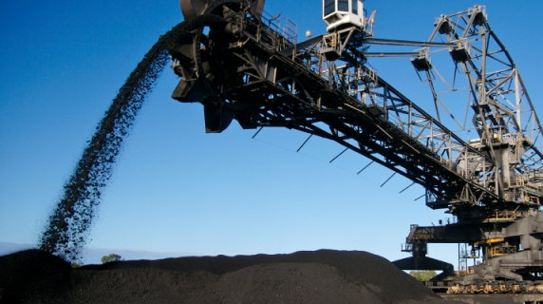

COAL AND PETROLEUM
Another important resource fossil fuels that is
Coal
Petroleum
which are important sources of energy for us.

Slide 3
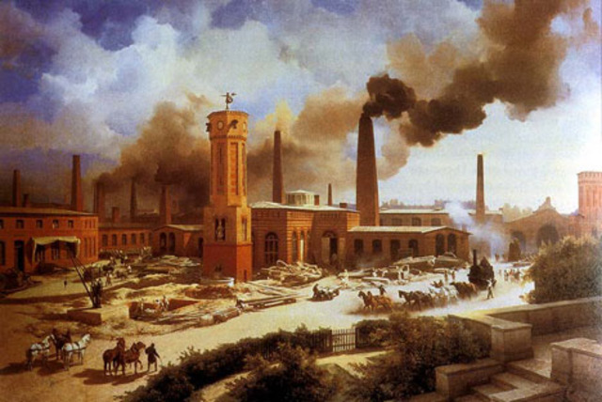




Since the industrial revolution, we have been using
increasing amounts of energy to meet our basic needs and for the manufacture of a large number of goods upon which our lives depend.
These energy needs have been largely met by the reserves of coal and petroleum.

Slide 4

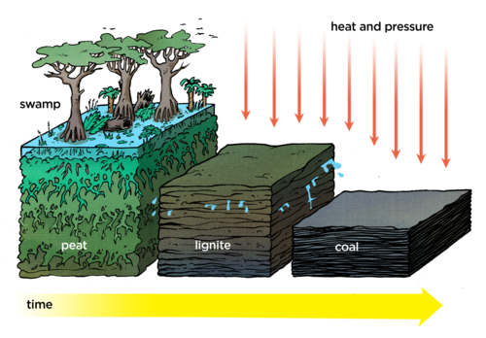

The management of these energy sources involves slightly different perspectives.
Coal and petroleum were formed from the degradation of bio-mass millions of years ago.

Slide 5
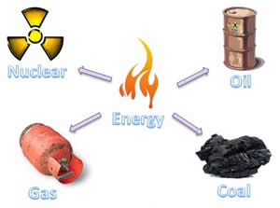
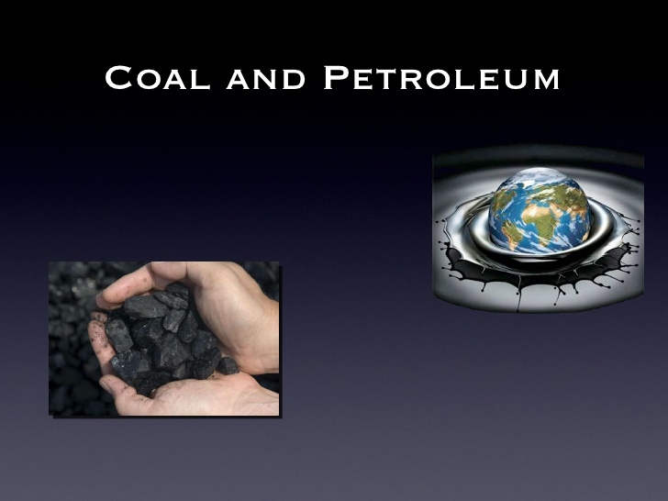
Hence these are resources that will be exhausted in the future no matter how carefully we use them.
Forty Years
Two Hundred Years
Our known petroleum resources will last us for about forty years and the coal resources will last for another two hundred years.

Slide 6


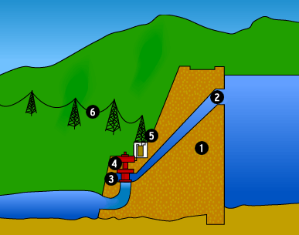

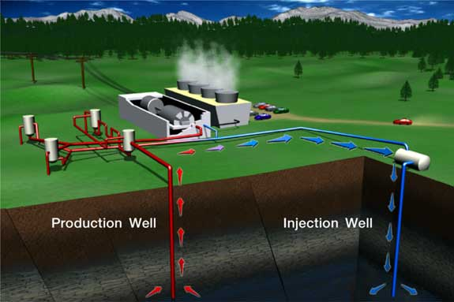


But looking to other sources of energy is not the only consideration
when we look at the consumption of coal and petroleum.

Slide 7
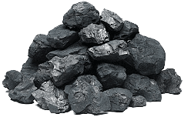
Since coal and petroleum have been formed from bio–mass, in addition to carbon, these contain hydrogen, nitrogen and sulphur.
S
N₂
H₂
C

Slide 8


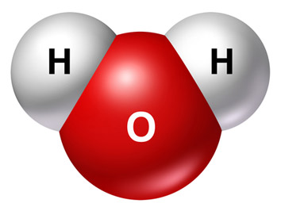

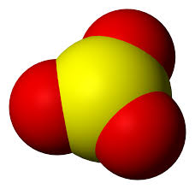

When these are burnt, the products are carbon dioxide, water, oxides of nitrogen and oxides of sulphur.
Carbon dioxide
Water
Oxides of sulphur
Oxides of nitrogen

Slide 9

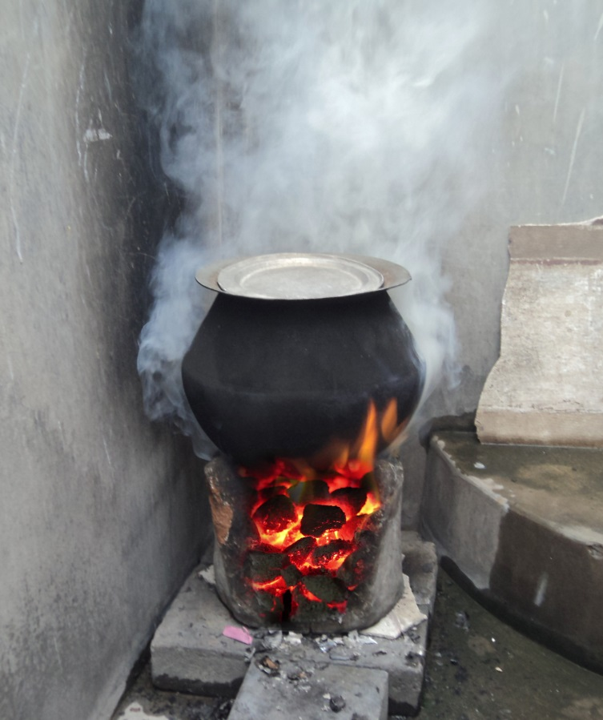

When combustion takes place in insufficient air (oxygen), then
carbon monoxide is formed instead of carbon dioxide.
Carbon dioxide
Carbon monoxide

Slide 10


These products, the oxides of sulphur and nitrogen and carbon monoxide are poisonous at high concentrations and carbon dioxide is a green-house gas.
Oxides of sulphur
Oxides of nitrogen
Carbon monoxide

Slide 11
Thank You

